Slide 1
TRANSFORMING GLOBAL LEARNING PARADIGMS
Artificial Intelligence in the Education System
Adaptive pathways, automated educator workflows, and the future of human-guided instruction

Slide 2
Market Trajectory & Global Adoption
Rapid expansion driven by institutional transformation and digital learning investments
Exponential Sector Growth
Global valuation surging toward a 34.5% compound annual growth rate.
$136.8B
Projected Market Size by 2035
High Stakeholder Utilization
Rapid capital deployment across K-12 and higher education institutions worldwide.
Over 86% of educational organizations actively deploy generative tools.

Slide 3
Core Pillars of AI Integration
Key operational domains reshaping modern institutional frameworks
Adaptive Learning
Predictive Analytics
Automated Feedback
Dynamic pacing matching individual skill levels.
Early warning signals reducing student dropout rates.
Instant evaluation for routine formative tasks.

Slide 4
Stakeholder Adoption Rates
Current utilization metrics across students, leaders, and teachers
Students utilizing AI for study support
95%
Education leaders using AI tools daily
53%
Teachers integrating AI weekly
36%

Slide 5
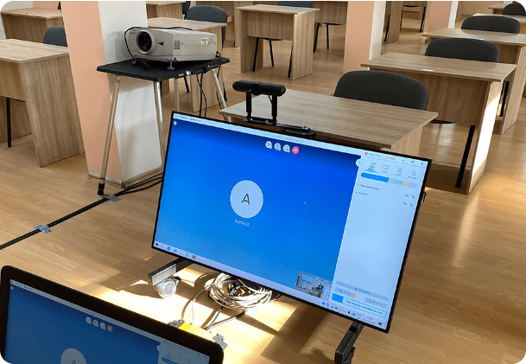
Modern Classrooms in Action
Technology-enabled learning environments bridging knowledge gaps
Interactive Digital Screens
Real-time collaborative problem solving during lessons.
Personalized Workstations
Targeted modules meeting unique student capabilities.

Slide 6
Redefining Educator Workflows
Shifting time from administrative burdens to active student mentorship
Administrative Savings
55%
80% of teachers report faster assignment and worksheet prep.
Improved Learning Outcomes
Educator consensus on student achievement gains when AI tools are integrated responsibly.
Targeted Interventions
Data-driven alerts surface student learning gaps early.

Slide 7

Academic Efficiency & Performance
Key performance indicators across adaptive tutoring trials
Student Engagement Increase
60%
Learning Efficiency Gain
57%
Task Distribution Share
69.6% of market revenue focuses on intelligent software solutions and adaptive learning platforms.
Course Completion Rate Boost
70%

Slide 8

Higher Education & Research Support
Collaborative environments empowered by advanced analytical tools
Effective Literature Synthesis
73% of researchers report high efficacy when using AI for literature reviews.
Campus Inquiry Management
Chatbots successfully resolve nearly 91% of administrative inquiries instantly.

Slide 9
Teacher Empowerment & Time Savings
Key task areas where AI reduces educator friction
Assignment Prep
Grading Assistance
Yearly Savings
80% faster worksheet creation.
79% reduction in grading time.
Average 6 weeks saved per year.

Slide 10

Governance Gaps & Policy Challenges
Rapid adoption has outpaced formal institutional frameworks
Limited Institutional Guidance
Only 20% of universities currently maintain a formal AI policy.
Primary Educator Concerns
Plagiarism risks and data security remain top institutional priorities.

Slide 11
Regional Growth & Global Momentum
Comparative growth indicators across key international markets
Asia-Pacific EdTech Growth Rate (CAGR)
48%
North American Market Share
38%
Educators Reporting Positive Impact
55%

Slide 12
THE PATH FORWARD
Balancing Innovation with Human Guidance
Technology empowers efficiency, personalization, and scale, but empathy, mentorship, and critical human connection remain irreplaceable.

Slide 13



Image Sources
https://avonic.com/wp-content/uploads/2020/12/Stories_Header_CaseStudy-HyperionHighschool.png
Source: avonic.com
https://library.hull.ac.uk/image-library/general/brynmor-jones-library-2862.x30b4dad4.jpg?w=1200&h=800&crop=800,800,200,0&h=800&f=webp&q=80
Source: library.hull.ac.uk
https://res-2.cloudinary.com/adiutor-co/image/upload/q_auto/v1/ghost-blog-images/happy-black-teacher-schoolgirl-using-digital-tablet-classroom_637285-9450.jpg
Source: adiutor.co

